Slide 1
Aqua-Zoo Management
Project team:
Akash Rajendra Ventekar
Aadil Ahmed Adam
Poornima Byre Gowda
Jeevan Chandrashekar

Slide 2
Introduction
Maintain database of the animals in the zoo and their description.
Maintain a record of trainers and their information
Display the available sponsors for the animals present in the zoo.
Admin rights to insert, update and delete any of the information to/from the database.
The database is implemented on Cloud9.

Slide 3
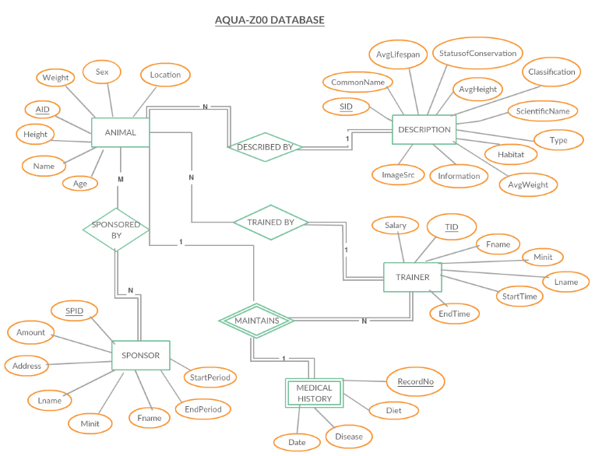

Slide 4
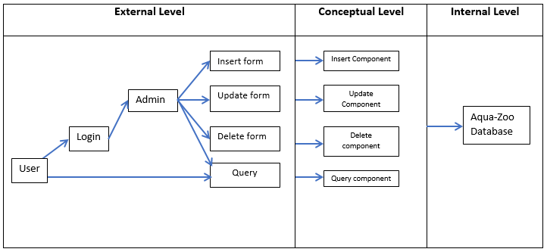
Architectural Design

Slide 5
Thank you

